Slide 1

Phishing Awareness: Your First Line of Defence
Phishing accounts for 80% of all reported security incidents in the UK, leading to significant financial losses. This module will equip you with the knowledge to understand, identify, and effectively report phishing attempts, making you the first line of defence against cyber threats.

Slide 2
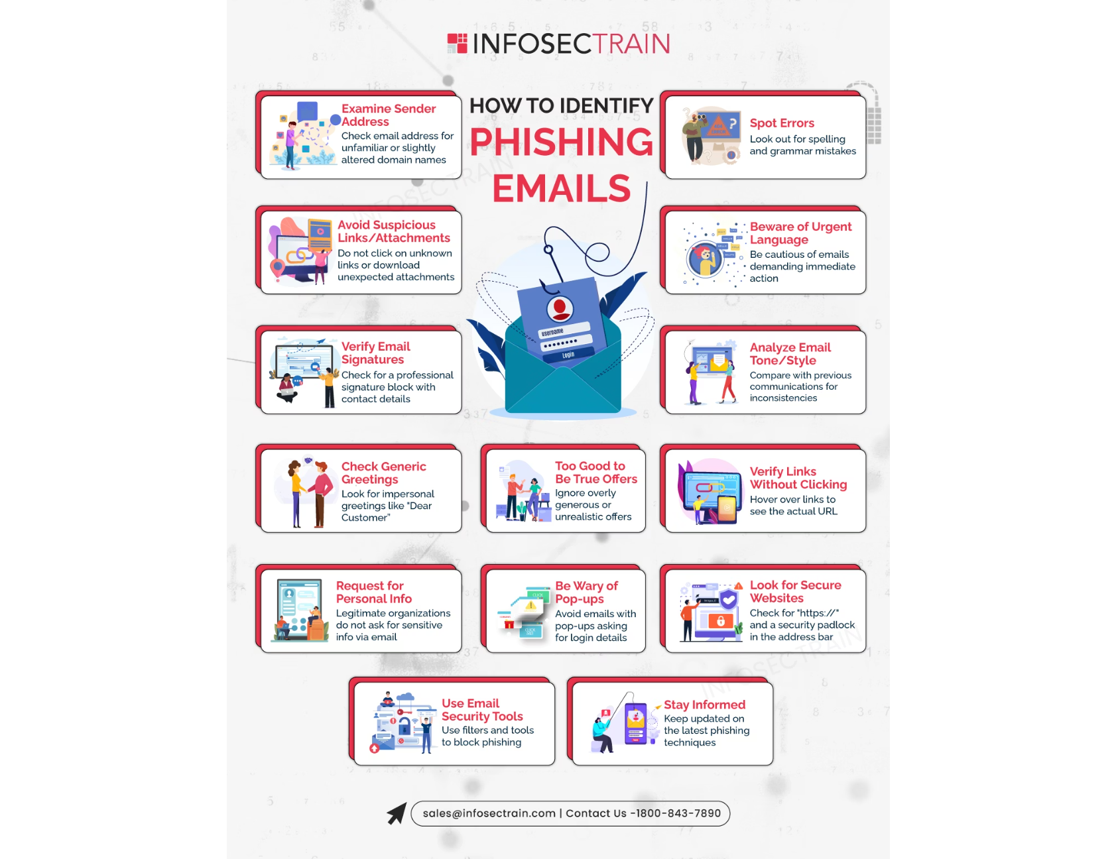
Spotting Phishing Emails: The Red Flags
Suspicious Sender
Unrecognised email address or domain mismatch.
Urgent Language
Demanding immediate action or threatening consequences.
Generic Greetings
"Dear Customer" instead of your name.
Unexpected Attachments
Unsolicited files (.zip, .exe) or strange links.
Poor Grammar/Spelling
Frequent errors indicating an unprofessional source.

Slide 3

Identifying Fake Websites: Don't Get Fooled!
URL Discrepancies
Typos in the domain (e.g., 'gooogle.com').
Missing HTTPS
Legitimate sites use secure 'https://' and a padlock icon.
Poor Design
Unprofessional appearance or pixelated logos.
Excessive Information
Asking for more personal data than necessary.
Pop-up Windows
Unexpected pop-ups requesting login credentials.

Slide 4





Understanding Social Engineering Tactics
Urgency/Fear
Authority
"Your account will be suspended in 24 hours!"
Impersonating IT Support, CEO, or Police.
Curiosity/Greed
Helpfulness
"Click here to win a free iPhone!"
Pretending a colleague needs "urgent help."

Slide 5
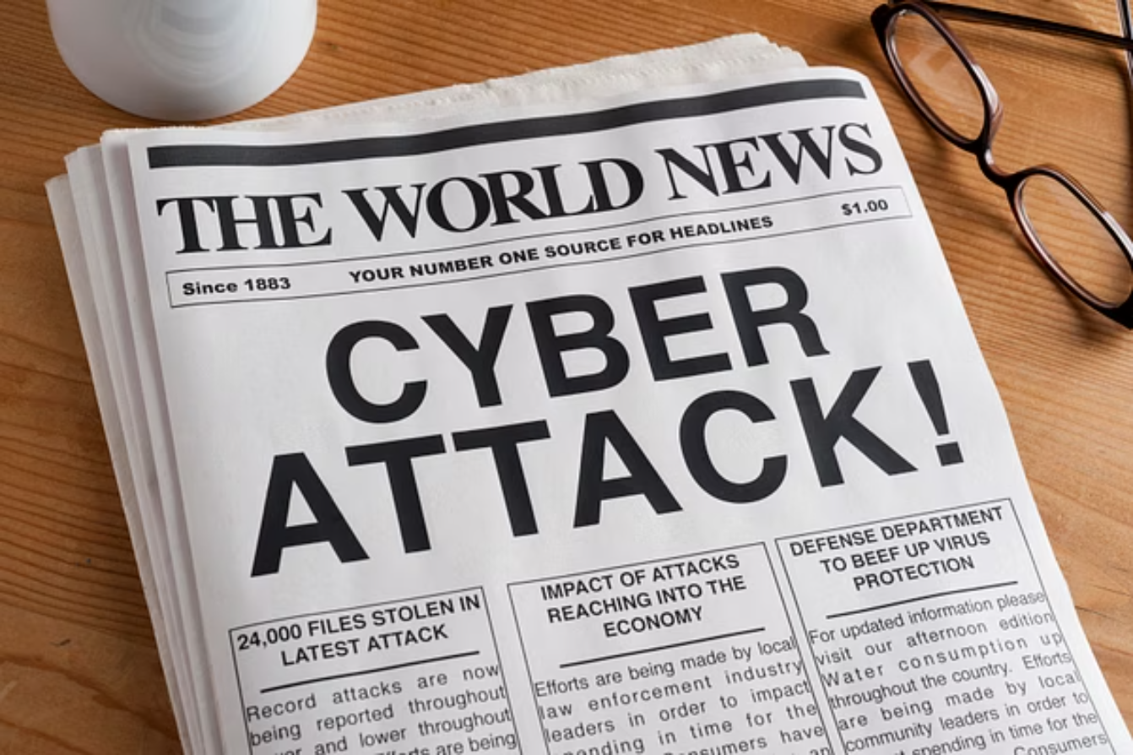
Phishing in the Wild: Real-World Cases
HMRC Tax Refund Scams: Over 300,000 fake emails reported in 2023.
COVID-19 Phishing: Fake NHS test & trace, vaccine booking scams.
"CEO Fraud" (BEC): UK businesses lost £33.4M in 2022.
Microsoft 365 Credential Theft: Common tactic for corporate access.
Amazon/PayPal Impersonation: Millions of fake deli
very or payment emails.

Slide 6





Your Defence Kit: Best Practices
STOP. THINK. CHECK.
Always verify sender, URL, and content.
Never Click Suspicious Links
Hover over links to see the actual destination.
Report Suspect Emails
Use your organisation's "Report Phishing" button.
Strong Passwords + MFA
Use a password manager; enable Multi-Factor Authentication.
Keep Software Updated
Patch operating systems and applications regularly.

Slide 7

Test Your Knowledge: Phishin
g Awareness Quiz
Engage with these scenarios to reinforce your understanding:
Scenario 1
Scenario 2
Identify red flags in a sample email.
Spot the fake URL in a list of website addresses.
Scenario 3
Scenario 4
Which social engineering tactic is used?
Safest action for a suspicious email?

Slide 8

Stay Safe, Stay Smart: Conclusion
Phishing attacks are constantly evolving, and your vigilance is crucial. Your awareness not only protects company data but also your personal finances. Remember: When in doubt, report it, then delete it. Together, we build a stronger cybersecurity defence.

